Slide 1

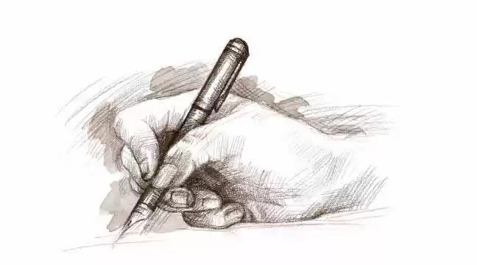
HANDWRITING RECOGNITION USING CNN
Project Guide:
VIMALA MATHEW
SCIENTIST/ENGINEER ‘D’

Slide 2

TEAM MEMBERS
ATHUL TP
NAVEED P
SACHIN DK
VISHWAJITH IP

Slide 3
CONTENTS
Introduction
Data source
System Design
About Dataset
Preprocessing Data
Building the Model
Model Summary
Sample Output
Improving the Model
Summary
Future scope

Slide 4
INTRODUCTION
Handwritten text recognition systems transcribe text image to digital text.
We are building a neural network which is trained on word images from IAM-dataset.

Slide 5
DATA SOURCE
http://www.fki.inf.unibe.ch/databases/iam-handwriting-database

Slide 6

EXAMPLE

Slide 7
SYSTEM DESIGN
Reading the image and target values from IAM dataset.
Preprocessing the data.
Building the model.
Compiling the model.
Training the model.
Testing the model.

Slide 8
ABOUT DATASET
We are using IAM Dataset
The IAM Handwriting Database contains forms of handwritten English text which can be used to train and test handwritten text recognizers.
657 writers contributed samples of their handwriting
1'539 pages of scanned text
5'685 isolated and labeled sentences
13'353 isolated and labeled text lines
115'320 isolated and labeled words

Slide 9
PREPROCESSING DATA
We want the neural network to understand the writing style of individual writer and we would prefer that this neural network be text independent (can work on any language).
So instead of passing individual sentences or words, we will pass it random patches of text. This is done by randomly cropping 113x113 sized patches from every sentence.

Slide 10
PREPROCESSING CODE
X_train=X_train.reshape(X_train.shape[0],113,113,1)
X_test=X_test.reshape(X_test.shape[0],113,113,1)
X_train=X_train/255
X_test=X_test/255

Slide 11
BUILDING THE MODEL
We build a Convolution Neural Network (CNN) in Keras using Tensorflow backend. We will use a standard CNN with multiple convolution and maxpool layers, a few dense layers and a final output layer with softmax activation.
RELU activation is used between the convolution and dense layers and model was optimized using Adam optimizer.
The size of the model needs to be proportional to the size of the data. Three blocks of convolution-maxpool layers and couple of dense layers is sufficient for this problem.

Slide 12
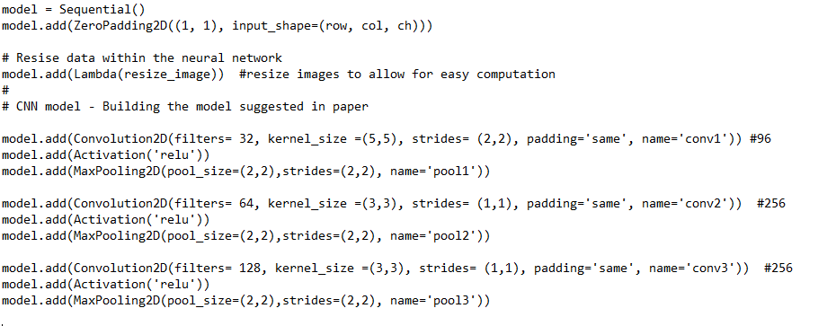
MODEL CREATION

Slide 13
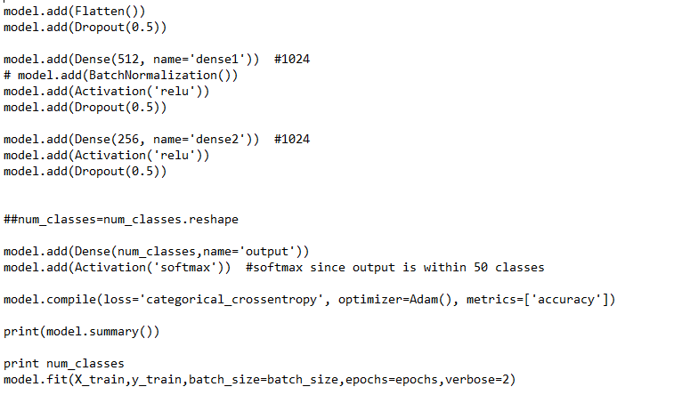

Slide 14
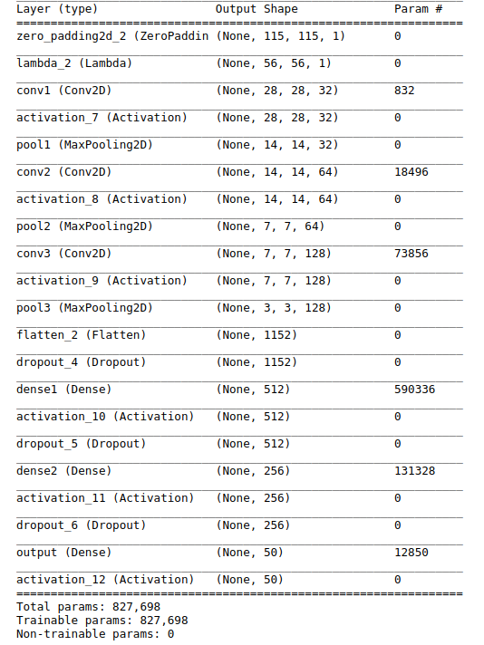
MODEL SUMMARY

Slide 15
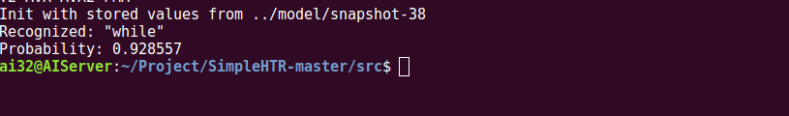
SAMPLE OUTPUT

Slide 16
IMPROVING THE MODEL
To improve the recognition accuracy, we can follow one of these steps:
Data augmentation: increase dataset-size by applying further (random) transformations to the input images.
Remove cursive writing style in the input images.
Increase input size (if input of NN is large enough, complete text-lines can be used).
Add more CNN layers.
Decoder: use token passing or word beam search decoding to constrain the output to dictionary words.
Text correction: if the recognized word is not contained in a dictionary, search for the most similar one.

Slide 17
SUMMARY
Handwriting recognition using deep learning is a very powerful technique for several reasons:
It automatically identifies deep powerful features
Our approach of feeding in random patches makes the model text independent
High prediction accuracy makes it possible to use this in practical applications

Slide 18
FUTURE SCOPE
This model can be used in universities to understand about ancient scripts.
This can also be used in pharmacies to understand doctors prescription.

Slide 19
THANK YOU

